Slide 1



UNIT 3: School
Happy friendship day!

Slide 2
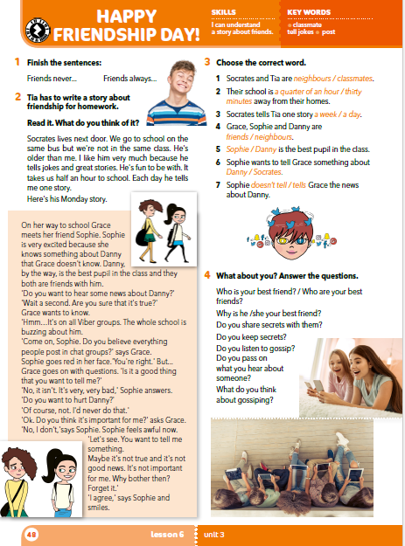
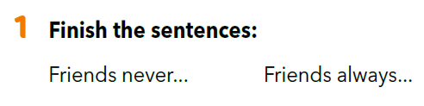



Slide 3
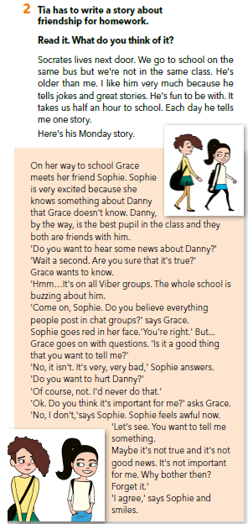
Read the text and answer the questions:
Who tells the story?
Who is the school buzzing about?

Slide 4
Translate
tell jokes =
excited =
post =
hurt =
feel awful =
classmate =
šaliti se
uzbuđen
objaviti
povrijediti
užasno se osjećati
učenik iz razreda

Slide 5

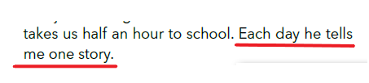


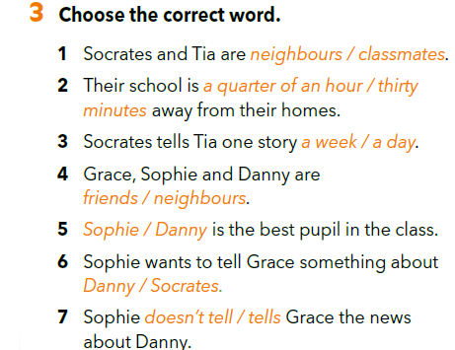
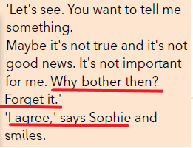
Choose the correct word. Explain your choice by underlying the sentence(s) in the text.

Slide 6
Do you like the story?
Why? Why not?
Nacrtaj strip na temelju Sokratove priče. Strip se treba sastojati od 6 sličica i uključivati dijelove teksta (ne trebaš spomenuti sve rečenice iz teksta).
Does this happen in your shool?
What do you do when you hear something like this?
Practise retelling the story.
Is everything online true?

Slide 7
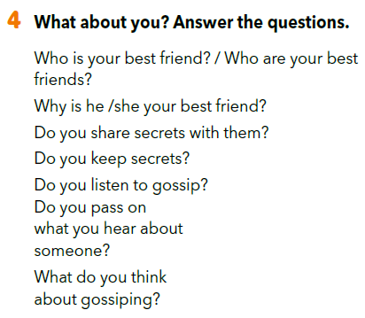

Slide 8
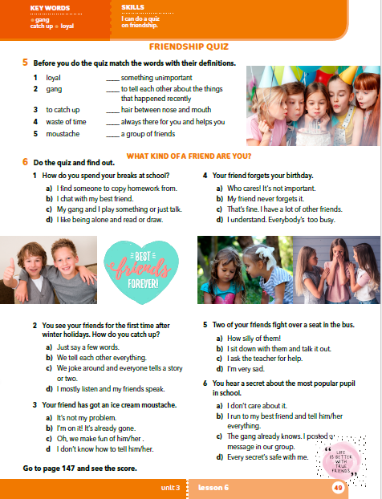
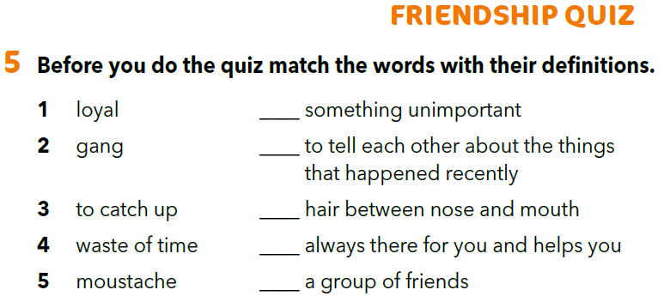
Match the words with their definitions.
Match the texts with the pictures.
https://www.bookwidgets.com/play/t:qT4nrtTVJUNSK3wGxV+AqVgj2eYiz65vYAHgibpD3WVCRUtaODY=
4
Open your book at page 49.
3
5
1
2

Slide 9
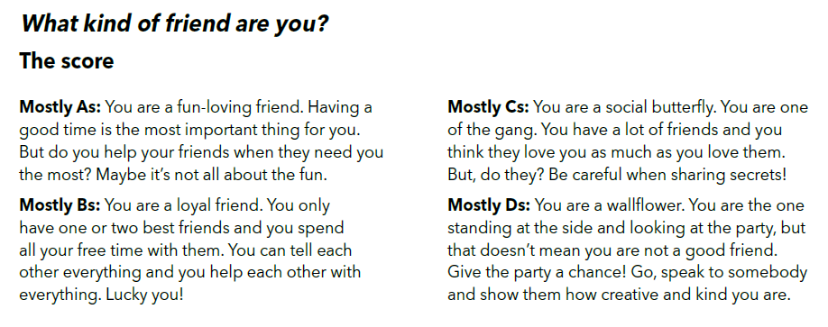
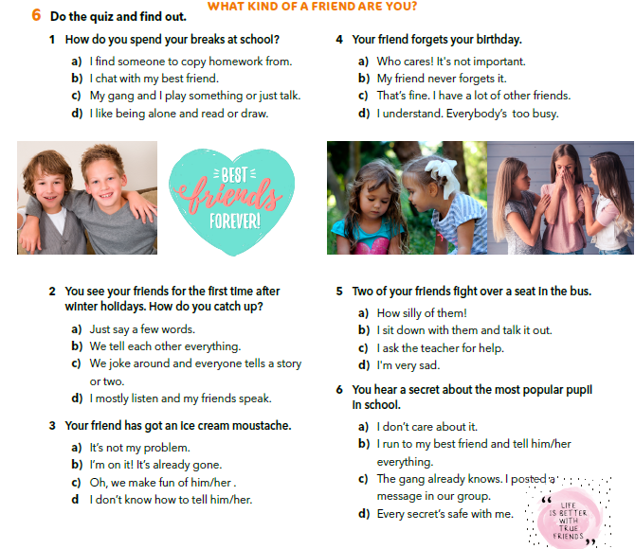
You can find the score at page 147.
What kind of friend are you?

Slide 10
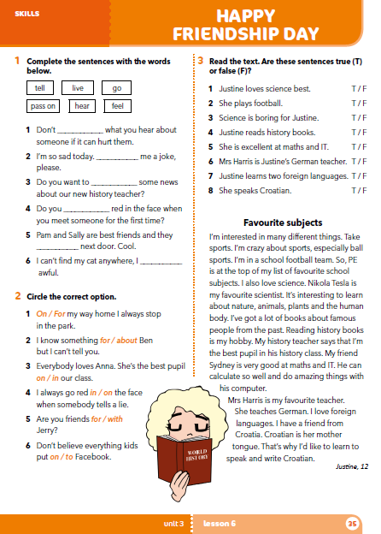
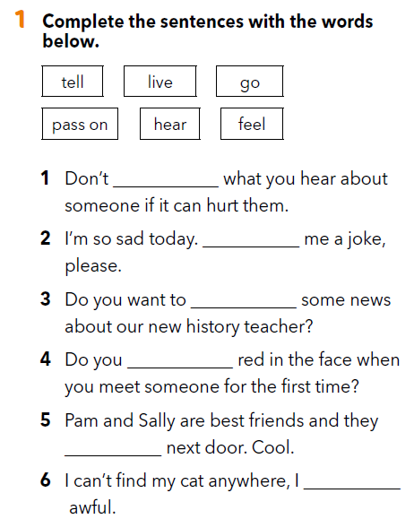
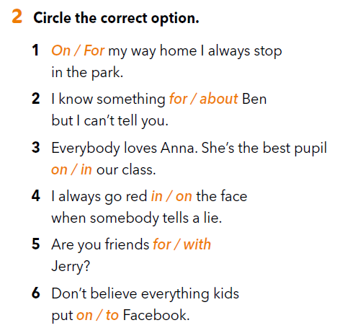
Workbook p 35.
pass on
Tell
hear
go
live
feel

Slide 11
